Slide 1
The Home Front
The Civil War Curriculum

Slide 2
Inquiry Question:
How did those who were not on the “front lines” contribute to the war effort?
Notes:
Ask students to create a hypothesis of the answer to this question. Have students either discuss in groups their ideas or as a class. Ask students how they produced those hypothesis.

Slide 3
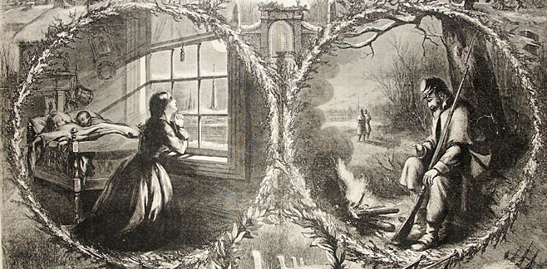
The Home Front
Notes:
Almost every family had a son, husband, sweetheart, brother or father away at war. For those who remained behind, the Civil War changed their lives forever.
Discussion Questions:
What does the kneeling woman symbolize?
Answer : praying and hoping for the safe return of a loved one in battle, most likely a father and a husband in this case
What is the soldier doing?
Answer : reading letters by a fire. Letter writing was a way for soldiers to communicate with loved ones back home during the war

Slide 4


The Role of Women
Activity:
Watch The Role of Women
Notes:
Watch the In4 video on Women in the Civil War https://www.battlefields.org/learn/videos/women-and-civil-war

Slide 5
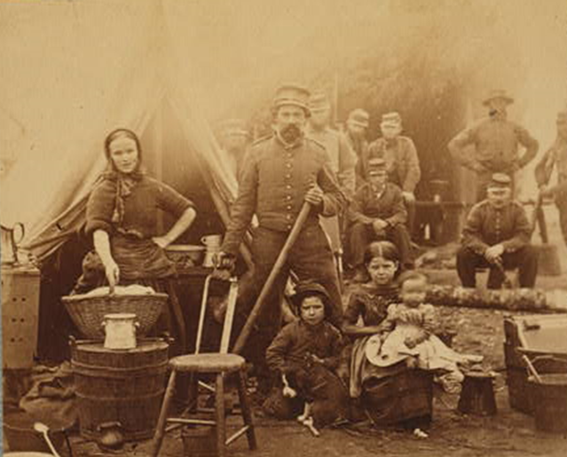
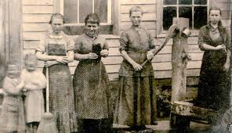
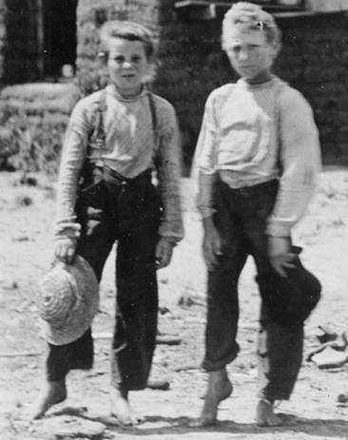
The Role of the Family
Notes:
Sometimes families followed soldiers into the army.
Discussion Question:
What do you think life was like for children in camp?
Do you think it was easier for women and children to stay home or to follow their husband/father to the war front?
Children worked the fields for the family while their fathers and older brothers were away at war.
Discussion Question:
Why would the children have to work in the fields more?
What other ways would life have changed for children and women on the families farm when fathers and older brother went away to war?

Slide 6
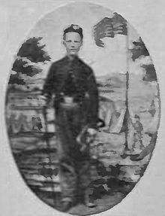

Children Entering War
Johnny Cook
  bugler with Battery B, 4th U.S. Artillery
  awarded the Medal of Honor for his actions at Antietam at 15 years old.
  acted as cannoneer under severe fire
Tillie Pierce
  15-year-old on July 1, 1863
  Escaped Gettysburg, PA after the fighting
  Nursed wounded the J. Weikert Farm south of town.
  Wrote about her experiences in an article, “What a Girl Heard and Saw of the Battle.”
Notes:
Discussion:
Do you think that children were often caught in battle?
Do you think children often joined battle and went to the war front?
Most soldiers were between the ages of 18 and 39 with an average age of 25. But 10% of Union soldiers were under the age of 16. Why do you think 16-year-olds and younger would join the war? Why do you think they would stay home?
Were children near battles more in the North or South?
Answer : most battles were fought in the South, which directly affected the lives of those on the home front, sometime with battles being fought in their own backyards

Slide 7
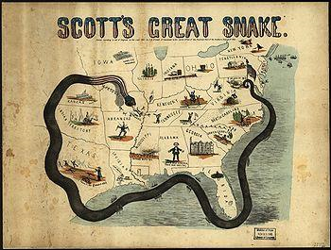
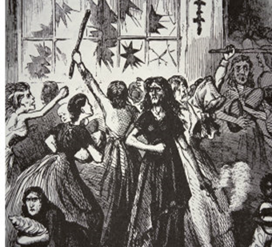
Challenging Times
“Bread Riots,” a civil unrest action where women and children looted stores, began in Southern Cities because
  Inflation had increased prices
  Refugees had flooded cities (For example, Richmond's population tripled from 38,000 people in 1860 to over 100,000 by 1863)
  Foraging armies ravaged crops and killed farm animals
  Internal transportation of goods in the South became difficult as railroad lines were destroyed and ports were cut off because of the “Anaconda Plan”
  The drought of 1862 resulted in a poor harvest
  Salt, which helped preserve meat, was expensive and scarce
The Siege of Vicksburg forced families to live in caves and trenches for 47 days to escape the bombardment of infantry on the city; many starved from lack of food
Notes:
Particularly in the South families faced shortages in raw materials, food, clothing and medical supplies due to the Union Navy blockading Southern ports.
Notes for the Teacher: Above is a cartoon illustration of the “Anaconda plan” a plan developed to block the Southern ports, surround, and essentially disable the Confederacy. This plan was successful in ending the Confederacy, but it hurt civilians because it limited supplies from being imported into the South
Discussion Question:
Why do you think women rioted in Richmond, Virginia? Why do you think it was just women?

Slide 8
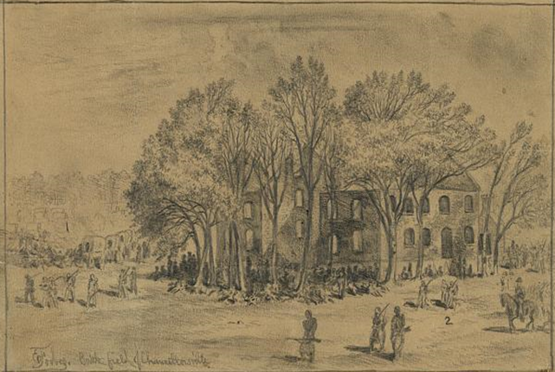
Challenging Times
Civilians who had homes near battles often had their homes destroyed or taken over for use as field hospitals.
  The Chancellor family was trapped between the armies in May 1863 when their home became General Hooker’s Headquarters.
  Sue Chancellor was 16:
    “Oh! Such cannonading on all sides, such shrieks and groans, such commotion of all kinds!”
  She and 15 other women and girls hid in the basement, with shin deep water, as the Battle of Chancellor commenced
  Her home became a hospital, the grand piano became the amputating table. The house caught fire from shelling and burned to the ground later in the battle
Notes:
Discuss how sometimes the “front lines” became the “home front” depending on when and where the battles took place?
Image information:
Battlefield of Chancellorsville House after the Battle
Notes:
Sue Chancellor was 16 in May 1863 when her home was between the armies and General Hooker took it for his headquarters. She left a detailed description of the ordeal she faced in company with 15 other women and girls, including relatives, neighbors, and a young abandoned black girl. Water stood shin deep in the basement where they crouched for protection.
“Oh! Such cannonading on all sides,” Sue wrote of May 2, “such shrieks and groans, such commotion of all kinds!”
Her home became a hospital, the grand piano became the amputating table. Arms and legs were thrown out the window. The house caught fire from shelling and burned to the ground. Luckily all the family got out alive.

Slide 9
Inquiry Question:
How did those who were not on the “front lines” contribute to the war effort?
Notes:
Discuss with the students on whether their hypothesis were correct or not. Discuss what the students learned from their primary and secondary sources.

